Slide 1
Technical and Business Writing
An overview

Slide 2
We began with the difference of,
Technical writing
Not general
Non-productive and objective
General writing
Simplified language without any technicalities
Productive and subjective in nature

Slide 3
We discussed that technical writing has three purposes,
To inform
To persuade
To instruct

Slide 4
The writing style that we should and must follow is,
Simplicity
SCOP
E
Clarity
Objectivity
Precision
Economy

Slide 5
Focusing on the specific and only writing style
General writing
Academic writing
TECHNICAL WRITING
As in “Technical” and Business Writing

Slide 6
The Technical Writing Process
Prewriting
Investigation
The Road Map
Drafting
Editing & Revision

Slide 7
There is always a “Pre-writing” stage
1.Get to know the purpose
2.Get to know the audience
3.Get to know the context/situation of communication
4.Get to know the required document type (format, sections, layout)

Slide 8
…in which we think about the “Purpose”
To instruct
To persuade
To record
Purpose
To recommend
To inform(for decision making)
To inform (without decision making)

Slide 9
…and consider our “Audience”
1. Executives
2. Technologists, engineers and scientists
3. Technicians
4. Operators
5. Non-technical persons

Slide 10
After pre-writing, purpose and audience analysis, we “investigate”
Data collection
Data analysis
Work out with take- home messages
1
2
3

Slide 11
While investigating and coming across data, you will have two types of data,
1
Secondary
Data
2
Primary
Data

Slide 12
Sources for secondary data
Tech magazines
Research papers/articles
Technical Reports

Slide 13
Sources for primary data
IEEE
ACM
Sage
Emerald
Taylor and Francis
Wiley
Elsevier
Routledge
Springer
The data bases

Slide 14
Two types of studies can be done in technical writing,
Qualitative
Quantitative

Slide 15
Qualitative data can be analyzed by
Thematic analysis
Qual. data
Content analysis

Slide 16
Quantitative data can be analyzed by,
Arithmetic
Quant. data
Statistical

Slide 17
We also talked about data collection tools and sampling techniques…

Slide 18


Slide 19
We talked about CVs/Resumes

Slide 20
Three types for CV/Resume
Chronological
Functional
Combination

Slide 21
We discussed three types of cover letters,
Application
Prospecting
Networking

Slide 22
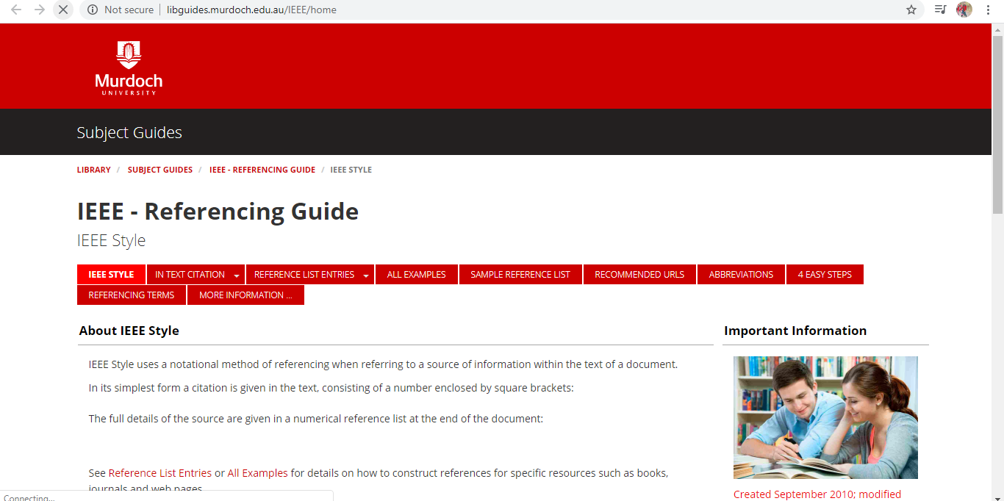
We discussed IEEE as well

Slide 23
We learnt about reading research papers,
The critical reading of paper
The evaluation of paper
The ground rules for becoming a researcher

Slide 24
In research papers, we got to know about the two kinds of papers,
Review articles/ Survey papers
It overviews the scientific field or topic conducted and summarizes.
Can be called as a stand-alone literature review
Primary research papers
It has the original data and results of the experiments a researcher was involved in.
Review articles or stand-alone literature review becomes the part of this.

Slide 25
We saw that primary and secondary sources are different from each other…

Slide 26
Primary research talks about
Research Problem/Hypothesis
Methods
Result

Slide 27
Secondary sources are,
Literature reviews/ survey/ review articles
Chapters in books
Any recorded interview or speech

Slide 28
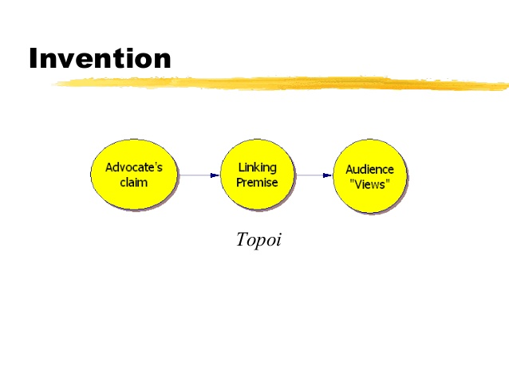
Moreover, we discussed about
TOPOI OF INVENTION
an advanced brain storming tool

Slide 29
As a technical writer, we learnt about compiling a user guide/instructional manual

Slide 30
Writing user guide has following phases,
1. Audience Analysis
2. Determination of Manual Type
3. Researching content and material for manual
4. Deciding on manual production
5. Preparation of Graphics
6. Revision and production of manual

Slide 31
TECHNICAL WRITING AND PROPOSALS

Slide 32
Types
Technical proposals
(External) Business proposals
Sales
Contract bids
(Internal) Problem-solution proposals
Any betterment proposal
Academic proposals

Slide 33
Nature of Proposals
Solicited
When the costumer asks for a proposal.
It can be asked verbal or through a written request
Unsolicited
When you send proposal without asking because you think it is a good idea

Slide 34
For any proposal, you will have following sections,
1. Introduction
2. Proposed Solution
3. Work flow
4. Fee Summary
5. Any other pointer

Slide 35
Academic proposal/Report/FYP Report
Introduction
Literature review
Methodology
Results and discussion
Conclusion

Slide 36
Introduction
INTRODUCTION
Background
Problem statement
Objectives
Research gap
Proposed solution

Slide 37
Literature review
Background
Frameworks
Concepts
Related studies
Deficiencies in related studies
Contextualization of studies with your project

Slide 38
Methodology
1.SPECIFICATION AND DESIGN
Details of the components used
Working of the components
Talks about the architecture
The uses for users
Procedure for working
Can be evolved while working
Justify your choice
Connect

Slide 39
…contd.
2.Implementation
Talks about codes and algorithms on a finer level
Realization of concepts and ideas
Solutions to problems

Slide 40
Result and evaluation
Talk about achieved goals
Talk about the reasoning about tests and methods you carried out
Critical evaluation of the achieved goals in the end and appraisal

Slide 41
Conclusion and future work
Conclusion talks about the overall summary and conclusion of the project
Future work would provide a starting point for the next research
Integrate the two.

Slide 42
Additional parts
Title page
Acknowledgment
Table of contents, figures
Abbreviations, glossary of terms
References and bibliography
Appendices

Slide 43
Technical and BUSINESS Writing

Slide 44
Business context has two types of communication:
Internal
External

Slide 45
Internal communication can be,
Upward
Downward
Horizontal/lateral

Slide 46
In business writing, we talked about
Minutes of meetings
Memorandum
Formal Letters

Slide 47
Minutes of meeting had three components:
Notice
Agenda
To be sent prior to any meeting
To be sent with notice
Minutes
To be written at the end of the meeting

Slide 48
Memorandum
An inside document
Saves time, inexpensive, informs
Semiformal in nature

Slide 49
Format of memo
1.Heading
2.Opening
3. Body
4. Closing

Slide 50
Formals letters have following approaches:
1. Direct (positive messages)
2. Indirect (negative messages)
4. AIDA (Attention, Interest, Desire, Action){persuasive messages)

Slide 51
And formal letters have three formats:
1. Full Block
2. Modified Block
3. Semi Block

Slide 52
Finito

